Slide 1
Engineering Management Principles and Economics (ENGR 301/R)
Lecture 6B
Changing Interest Rates
Present Worth Analysis
Dr C.J. Willis, CAPM, P.Eng
‹#›

Slide 2
Learning Objectives
Learners will:
Work through cash flow examples with changing interest rates
Be introduced to Present Worth Analysis
Present Worth Criteria
Comparing two choices using Present Worth
Equal, unequal, and infinite project lives
Multiple alternatives using Present Worth
Dr C.J. Willis, CAPM, P.Eng
‹#›

Slide 3
Changing Interest Rates
Up to now all cash flows used only one interest rate
Financial institutions sometimes use more than one interest rate to account for the time value of money
Dr C.J. Willis, CAPM, P.Eng
‹#›

Slide 4
Changing Interest Rates
Example:
You deposit $2000 in a registered retirement savings plan that pays interest at 12%, compounded quarterly, for the first 2 years and 9%, compounded quarterly for the next 3 years. Determine the balance at the end of 5 years.
P= $2000
r= 12% for the 1st two years and 9% per year for the last 3 years
M= 4 compounding periods per year, n= 20 quarters.
Find F
Dr C.J. Willis, CAPM, P.Eng
‹#›

Slide 5
Changing Interest Rates
We find the future value of the $2000 deposited after the first 2 years when the 12% interest rate is in effect.
We will need to determine the interest rate per quarter
We then apply the 9% interest rate per quarter to the future value of the $2000 at year two. This way, we find the future value of the deposit at year 5.
Dr C.J. Willis, CAPM, P.Eng
‹#›

Slide 6

Changing Interest Rates
i= 12% / 4 = 3% B2 = $2000 (F/P, 3%,8)
N= 4(2) = 8 quarters B2 = $2000(1.2668)
i= 9% / 4 = 2.25% F = B2(F/P, 2.25%,12)
N= 4(3) = 12 quarters F = $2533.6(1.3060)
Dr C.J. Willis, CAPM, P.Eng
‹#›

Slide 7
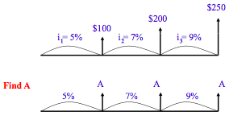
Changing Interest Rates
Example: Series of cash flows
Dr C.J. Willis, CAPM, P.Eng
‹#›
Notes:
How do we treat cash flows that have interest rates that change during the transaction period?
We basically apply each interest rate independently.
‹#›

Slide 8

Changing Interest Rate
P= 100(P/F,5%,1) + 200(P/F,7%,1)(P/F,5%,1) + $250 (P/F,9%,1)(P/F,7%,1)(P/F,5%,1) = $477.41
$477.41 = A(P/F,5%,1) + A(P/F,7%,1) (P/F,5%,1) + A(P/F, 9%,1)(P/F,7%,1)(P/F,5%,1) = 2.6591A
A= $179.54
Dr C.J. Willis, CAPM, P.Eng
‹#›

Slide 9
Present Worth Analysis
Present worth analysis is suitable for almost any economic analysis problem
It is particularly desirable when we wish to know the present worth of future costs and benefits
Present worth analysis helps us to determine the worth of income producing property, such as an oil well or an apartment building.
It is used when we want to choose between alternatives based on their future costs and benefits
Dr C.J. Willis, CAPM, P.Eng
‹#›

Slide 10
Assumptions in Solving Economic Analysis Problems
End of Period Convention
All cash flow amounts are calculated as amounts at the end of each period:
Now = end of period 0 (beginning of period 1)
Future amounts happen at the end of the period specified
No Sunk Costs
Only the current situation and the potential future is considered
Two viewpoints
Investor and Borrower (at some interest rate)
Conventional assumption—money required to finance alternative solutions is obtained at interest rate i
Dr C.J. Willis, CAPM, P.Eng
‹#›
Notes:
Here we have a series of cash flows and we want to find the uniform end of period cash receipt that they are equivalent to.
How do we do this?
We have to firstly find the present value of the three cash flows. We do this by recognizing and considering the effect of the three interest rates on each of the cash flows.
We then convert the present value into a uniform series cash receipt A, recognizing the interest rates applied at the three periods.
‹#›

Slide 11
Economic Rules
Alternatives are judged based on economic efficiency.
Present worth analysis typically follows these rules:
Input or Output | Situation | Rule
Fixed input | Amount of money or other input resources in fixed | Maximize present worth of benefits or other outputs
Fixed Output | There is a fixed task, benefit, or other output to be accomplished | Minimize present worth of costs or other inputs
Neither input nor output is fixed | Typical general situation | Maximize (present worth of benefits minus present worth of costs), that is, maximize net present worth
Dr C.J. Willis, CAPM, P.Eng
‹#›

Slide 12
Present Worth Techniques
In present worth analysis, careful consideration must be given to the time period covered by the analysis
Usually, the task to be accomplished has a time period associated with it.
The consequences of each alternative must be considered for this period of time, which is called the analysis period or planning horizon or project life.
Dr C.J. Willis, CAPM, P.Eng
‹#›

Slide 13
Present Worth Techniques
Three potential analysis periods are possible when comparing alternatives:
Equal lives (the useful life of each alternative equals the analysis period)
Not equal lives (the alternatives have useful lives different from the analysis period)
Infinite analysis period (the alternatives have infinite lives)
Present worth requires that the analysis is made between equal time periods
Dr C.J. Willis, CAPM, P.Eng
‹#›

Slide 14
Alternatives with Lives Equal to the Analysis Period
When selecting between two alternatives using present worth analysis:
Maximize:
Net Present Worth = Present worth benefits – Present worth of costs
NPW = PW of benefits – PW of costs
The alternative with the higher NPW is selected
PW, PV , NPW and NPV are often used a synonyms. Net is included to emphasize that both costs and benefits are included.
Dr C.J. Willis, CAPM, P.Eng
‹#›

Slide 15
Alternatives with Lives Equal to the Analysis Period
Example:
A firm is considering which of two mechanical devices to install to reduce costs. Both devices have useful lives of five years and no salvage value. Device A costs $1000 and can be expected to result in $300 savings annually. Device B costs $1350 and will provide cost savings of $300 the first year but will increase by $50 annually, making the second-year savings $350, the third-year savings $400, and so forth. With interest at 7%, which device should the firm purchase.
Dr C.J. Willis, CAPM, P.Eng
‹#›
Notes:
To convert $100 to a present value we apply the present worth factor using i=5%
To convert the $200 to a present value we apply two present worth factors, one for i=7% over 1 year, and then further adjust using a present worth factor for i=5% over 1 year
To convert the $250 amount to a present amount, we firstly adjust it by a present worth factor for i=9% over 1 year, then by a PW factor for i=7% over 1 year, then by a PW factor for i=5% over 1 year.
The total present value of the three cash flows is the summation of the present values of the three amounts.
We then say that this present value is equivalent to the sum of three equal end of period cash receipts at years 1, 2 and 3, considering the interest rates acting on each of them. We have to apply the present worth factors taking into account the interest rates which will act on each of them.
‹#›

Slide 16
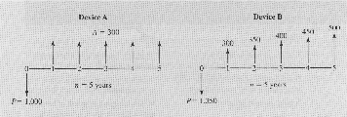
Alternatives with Lives Equal to the Analysis Period
PW_{A}= -1000 + 300 (P/A,7%,5) = -1000 + 300 (4.1) = $230
PW_{B}= -1350 + 300 (P/A, 7%,5) + 50(P/G,7%, 5)
= -1350 + 300(4.100) + 50 (7.647) = $262.4
Dr C.J. Willis, CAPM, P.Eng
‹#›
Notes:
If future income and costs are known, then we can use a suitable interest rate to calculate the present worth of the property.
‹#›

Slide 17
Alternatives with Useful Lives Different From the Analysis Period
It is NOT correct to analyse alternatives using NPW with different lives.
Methods to handle this problem:
Examine the alternatives using a ‘least common multiple of lives (LCM)’.
Decide on an analysis period if the LCM method is too onerous or doesn’t make sense.
(e.g., 7 and 13 years gives an LCM = 91 years)
We use an analysis based on how long the equipment is likely to be needed.
Dr C.J. Willis, CAPM, P.Eng
‹#›

Slide 18
Example: LCM
E.g., 10 year project life versus a 5 year project life
Least common multiple is 10 years
Reformulate 5 year life to 10 year life:
including the cash flows in years 0 to 5 and also in years 5 to 10
the alternatives can now be compared
20
20
32
20
20
32
20
20
32
6 7 8 9 10
0 1 2 3 4 5
0 1 2 3 4 5
10
10
10
30
30
30
5 year project now a 10 year project
Original 5 year project
Dr C.J. Willis, CAPM, P.Eng
‹#›

Slide 19
Example: LCM
A purchasing agent is considering the purchase of some new equipment for the mailroom. The following are the costs and useful lives of the equipment.
Which manufacturer’s equipment should be selected? Assume 7% interest and equal maintenance costs.
Manufacturer | Cost | Useful Life (Years) | End-of-useful-life Salvage value
Speedy | $1500 | 5 | $200
Allied | $1600 | 10 | $325
Dr C.J. Willis, CAPM, P.Eng
‹#›
Notes:
No Sunk costs: it is the differences between alternatives that is relevant in economic analysis. Events that have occurred in the past really have no bearing on what we should do in the future. Past costs have no bearing on deciding between alternatives unless past costs somehow affect the present or future costs.
Economic problems usually have two monetary viewpoints: financing (the obtaining of money) and investment (the spending of money).
‹#›

Slide 20
Example: LCM
Original Speedy Investment
PW of cost = 1500 + (1500-200)(P/F, 7%,5) – 200(P/F, 7%, 10)
= 1500 + 1300(0.7130) – 200(0.5083)
= 1500 + 927-102 = $2,325
$200
$200
0
1
2
3
4
5
6
7
8
9
10
$1500
$1500
Replacement Speedy Investment
Dr C.J. Willis, CAPM, P.Eng
‹#›

Slide 21
Example: LCM
PW cost = 1600 – 325 (P/F, 7%, 10) = 1600 – 325(0.5083)
= $1445
$325
0
1
2
3
4
5
6
7
8
9
10
$1600
Dr C.J. Willis, CAPM, P.Eng
‹#›

Slide 22
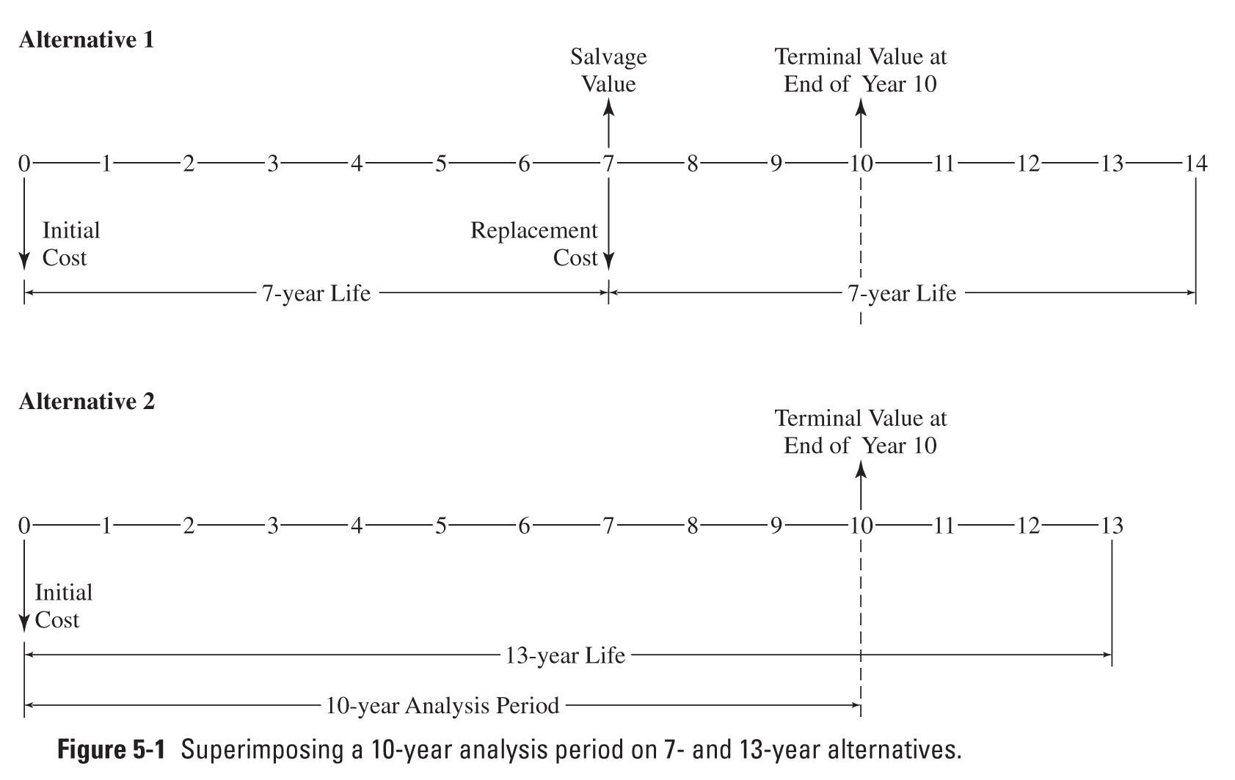
Example: Selecting an Analysis Period
Dr C.J. Willis, CAPM, P.Eng
‹#›

Slide 23
Example: Selecting an Analysis Period
The LCM of lives would be 91 years. An analysis period of 91 years for office equipment is hardly realistic.
Instead, a suitable analysis period should be based on how the equipment is likely to be needed.
This may require that terminal values be estimated for the alternatives at some point before the end of their useful lives.
Terminal value is the market value of the equipment at some point in time. It is the residual value of the equipment, similar to the salvage value
Here we use an analysis period of 10 years. Alternative 1 is replaced at year 7 by an identical piece of equipment. At year 10, the terminal values of both alternatives are determined.
The present worth of their costs are then determined by applying the appropriate single payment present worth factor
Dr C.J. Willis, CAPM, P.Eng
‹#›

Slide 24
Infinite Analysis Period: Capitalized Cost
The need for large-scale infrastructure projects (bridges, pipelines, etc.) is considered to be permanent.
These types of projects are considered to have an infinite analysis period.
We call this particular analysis capitalized cost
Capitalized cost is the present sum that is required to provide the service indefinitely.
Dr C.J. Willis, CAPM, P.Eng
‹#›
Notes:
In using the “least common multiple of lives” we treat the alternative with the lower useful life as being replaced with something identical at the end of its useful life.
E.g. If A has a useful life of 5 years and B has a useful life of 10 years, then we assume that after 5 years, A is replaced with something identical.
‹#›

Slide 25
Infinite Analysis Period: Capitalized Cost
Capitalized cost is the present sum of money that would need to be set aside now, at some interest rate, to yield the funds required for the service or whatever indefinitely.
To achieve this, the money set aside for future expenditures must not decline.
The interest received on the money set aside can be spent, but not the principal.
Dr C.J. Willis, CAPM, P.Eng
‹#›
Notes:
We repeat the cash flow for the first five years for the second period of five years
‹#›

Slide 26
Capitalized Cost, cont’d.
There can be an end-of-period withdrawal of A which is equal to P(i):
These withdrawals will never decrease the original principal.
A = Pi for n = infinity
Therefore:
Capitalized Cost = P = A/i
The money set-aside that can provide the funds for the project forever.
Dr C.J. Willis, CAPM, P.Eng
‹#›
Notes:
What if the alternatives had useful lives of 7 and 13 years? The LCM of lives would be 91 years. An analysis period of 91 years for office equipment is hardly realistic.
Instead, a suitable analysis period should be based on how the equipment is likely to be needed.
This may require that terminal values be estimated for the alternatives at some point before the end of their useful lives.
Terminal value is the market value of the equipment at some point in time. It is the residual value of the equipment, similar to the salvage value
Here we use an analysis period of 10 years. Alternative 1 is replaced at year 7 by something identical. At year 10, the terminal values of both alternatives are determined.
‹#›

Slide 27
Capitalized Cost (Example)
How much should one set aside to pay $50 per year for maintenance on a gravesite if interest is assumed to be 4%? For perpetual maintenance, the principal sum must remain undiminished after the annual disbursement.
Capitalized Cost P= Annual Disbursement A/ Interest Rate i
P = 50/0.04 = $1,250
Dr C.J. Willis, CAPM, P.Eng
‹#›

Slide 28
Summary
Present Worth Analysis is the first of three major analysis techniques for alternative comparison.
The criteria of analysis is determined based on the economic factors affecting the project.
It is an economic analysis that evaluates the current and future situation of each project.
Alternatives can be evaluated in almost any economic problem using Present Worth Analysis.
Dr C.J. Willis, CAPM, P.Eng
‹#›

